Slide 1




ANALYSIS ON NUMBER OF SECONDARY SCHOOLS AND ENROLLEES IN
THE PHILIPPINES: ENSURING ACCESSIBLE EDUCATION FOR ALL
Group 4| Presentation

Slide 2











Arnie B. Rivera
Jemery A. Gentiles
Juan Carlos Legaspi
Jeguer Torres
Rankin C. Asperin
Ana Beatriz B. Nolasco
Maria Luisa Li Chia
Jason S. Paquibulan
Reginald Viray

Slide 3

Education is the Backbone of the Nation

Slide 4
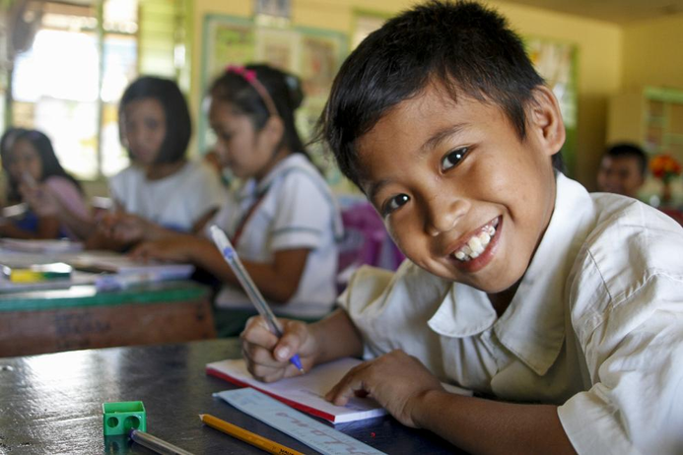
Introduction
The education sector is one of the most underdeveloped sectors in the Philippines. Its transition into new curriculum and developments in place has been hampered since pandemic started.
In order to address these challenges, a closer look at the number of schools and the number of students enrolled in them were investigated.

Slide 5




The Aims of the Study
To deliver a message in understanding the current education sector in the Philippines
To invite readers to understand how opportunity has been an inequity for students in the Philippines
This will help in understanding whether or not our education system is working effectively; if not, DEPED may need to rethink its education policy and approach.

Slide 6

Data
The study used SY 2016 to SY 2020 data published on the official website of Department of Education.

Slide 7
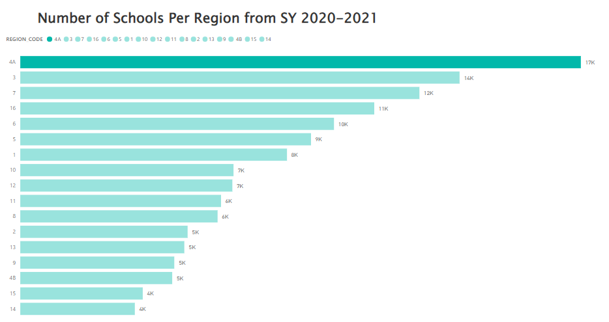
Discussion – Demographics of School per Region
Out of 17 regions, Region 4A (CALABARZON) has the biggest number of schools.

Slide 8
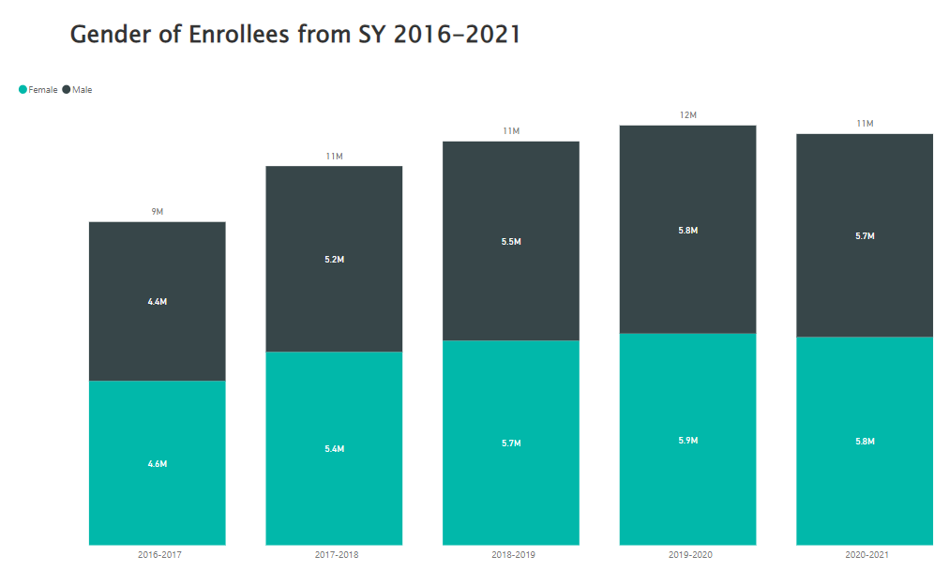

Discussion – Enrollees per Gender
There is little gender disparity in the number of enrollees .

Slide 9
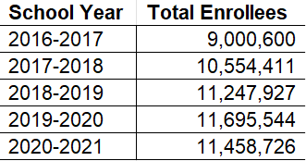
Discussion – Enrollment Rate
As per DepED statistical computation, Enrollment rate is measured based on last year data.
School Year Enrollment Rate
2017-2018 117%
2018-2019 107%
2019-2020 104%
2020-2021 98%
Enrollment rates for secondary schools have generally been good. More enrollment means more people are pursuing education. Schools depend on their enrollment numbers to survive. A significant drop of 2% in enrollment rate was noticed as restrictions were implemented during 2020.

Slide 10
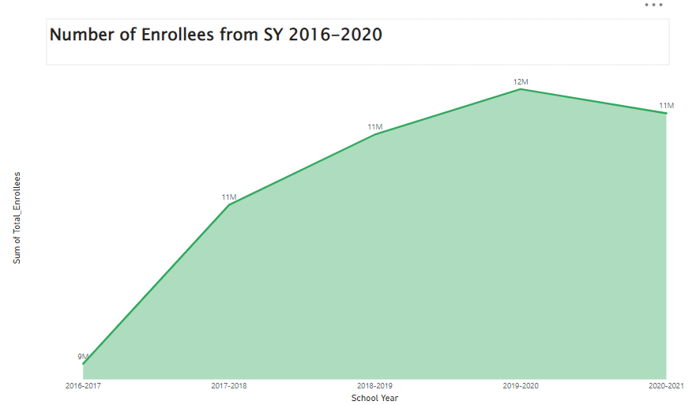
Discussion – Enrollment by School Year
Average growth rate of enrollees for the last five years is 27.31%, which is better than previous years average of 8.45%

Slide 11
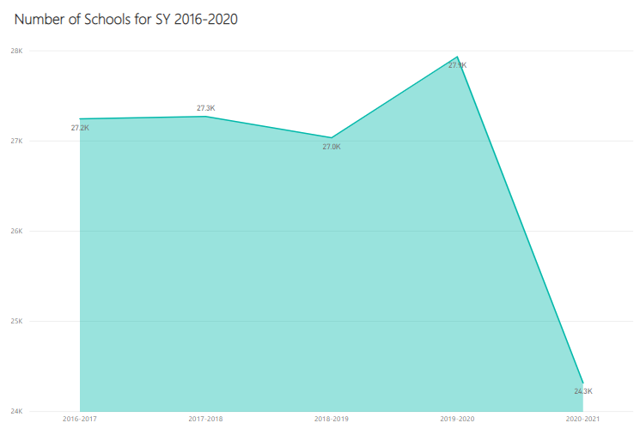
Discussion – Number of Schools by Year
Average decrease of schools for the last 5 years is 10.74%.

Slide 12
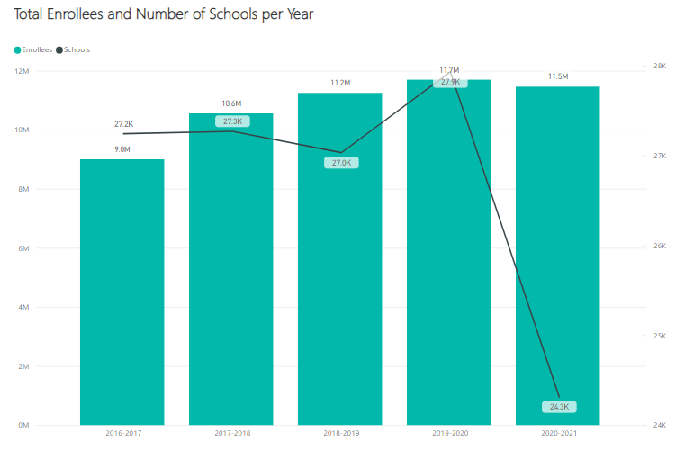
Trend Analysis of Enrollees and Schools
In our analysis, we noticed a consistent trend for number of enrollees.The trend is generally increasing, except for SY 2020 when lockdowns and restrictions happened.
As for schools, the trend has been erratic as low enrollment may have forced some school to close.

Slide 13
Conclusion
SUMMARY OF FINDINGS
The enrollment rates for secondary schools have generally been good.
Average growth rate of enrollees for the last five years is 27.31%
Average decrease of schools for the last 5 years is 10.74%.
There is a consistent trend for number of enrollees, except for outlier SY 2020.
There has been a significant drop in the number of secondary enrollees, during SY 2020-2021 resulting to 2% drop in enrollment rate.
As for schools, the trend has been erratic as low enrollment may have forced some school to close during the period covered.

Slide 14
RECOMMENDATION
Empirical data can be gathered using qualitative methods to shed light on the sentiments of teachers and students.
Further study for uncovering the underlying reasons and other factors for the low number of Secondary School enrollments.
We recommend that the researchers extend the study's time frame (10 years) in order to capture more insights. We can then measure and compare year-on-year growth in this manner.

Slide 15

Thank You

